Slide 1
Lecture - 05

Slide 2
Performance of a Computer
Response Time
The time between the start and completion of a task.
It is also known as execution time.
This includes disk accesses, memory accesses, I/O activities, operating system overhead, CPU execution time, etc.
Throughput
The total amount of job done in a fixed amount of time.
Decreasing response time almost always improves throughput.

Slide 3
Relation between Performance and Execution Time
Performance_{X} =1/ Execution time_{X}
For two computers X and Y, if the performance of X is greater than the performance of Y, then Performance_{X} > Performance_{Y}
= 1/ Execution time_{X} > 1/ Execution time_{Y}
= Execution time_{Y} > Execution time_{X}
If X is n times faster than Y, then Performance_{X} / Performance_{Y} = n
or, Execution time_{Y} / Execution time_{X} = n

Slide 4
Relative Performance
If computer A runs a program in 10 seconds and computer B runs the same program in 15 seconds, how much faster is A than B?
Performance_{A} / Performance_{B}
= Execution time_{B} / Execution time_{A}
= 15/10
= 1.5
A is 1.5 times faster than B.

Slide 5
Measuring Performance
Time is the measure of computer performance.
Computers are often shared. In such cases, the system may try to optimize throughput rather than minimizing the elapsed time for one program.
CPU execution time or CPU time is the time the CPU spends computing a task not including the time spent waiting for I/O or running other programs.

Slide 6
Measuring Performance
CPU time- 1. User CPU time
2. System CPU time
CPU time spent in the program is called User CPU time, and
The CPU time spent in the operating system performing tasks requested by the program is called System CPU time.

Slide 7
Measuring Performance
Suppose, after executing a program we get the following measurements:
User CPU time – 90.7 seconds System CPU time – 12.9 seconds Elapsed time – 159 seconds
CPU Utilization is (90.7+12.9)/159 = 65%
about 65.2% of the elapsed time, the CPU was actively processing the program
The term system performance is used to refer to elapsed time on an unloaded system while CPU performance refers to user CPU time on an unloaded system.

Slide 8
Clock Cycles
Almost all computers are constructed using a clock that runs at a constant rate and determines when events take place in the hardware.
Clock period is the time for a complete clock cycle.
Clock rate is the inverse of clock period.

Slide 9
CPU Time
CPU time for a program can be expressed in two ways: CPU time = CPU clock cycles for a program * clock cycle time or
CPU time = CPU clock cycles for a program / Clock rate
If we know the number of clock cycles and the number of instructions execute (Instruction count, IC), we can calculate the average number of clock cycles per instruction (CPI).
CPI = CPU clock cycles for a program / Instruction count
Instructions per clock (IPC) is the inverse of CPI.

Slide 10
CPU Time
CPU time = Instruction count * Cycles per instruction * Clock cycle time
or
CPU time = Instruction count * Cycles per instruction / Clock rate T = N * CPI / f
It is possible to compute the CPU clock cycles by looking at the different types of instructions and using their individual clock cycle counts.
CPU clock cycles = Σ(CPI_{i} X C_{i})
where C_{i} is the count of the number of instructions of class i executed, CPI_{i} is the average number of cycles per instruction for that instruction class, and n is the number of instruction classes.

Slide 11
Comparing Code Segments
 | CPI for this instruction class
 | A | B | C
CPI | 1 | 2 | 3
Code Sequence | Instruction count for instruction class
 | A | B | C
1 | 2 | 1 | 2
2 | 4 | 1 | 1
Which code sequence executes the most instructions?
Which will be faster?
What is the CPI for each sequence?
Sequence 1 executes 5 instructions and sequence 2 executes 6 instructions.
CPU clock cycles₁ = (2X1)+(1X2)+(2X3) = 10 cycles CPU clock cycles₂ = (4X1)+(1X2)+(1X3) = 9 cycles So code sequence 2 is faster.
Since sequence 2 takes fewer overall clock cycles but has more instruction, it must have a lower CPI.
CPI₁ = 10/5 = 2 CPI₂ = 9/6 = 1.5

Slide 12
Practice Problem
Our favorite program runs in 10 seconds on computer A, which has a 2 GHz clock. We are trying to help a computer designer build a computer, B, which will run this program in 6 seconds. The designer has determined that a substantial increase in the clock rate is possible, but this increase will affect the rest of the CPU design, causing computer B to require 1.2 times as many clock cycles as computer A for this program. What clock rate should we tell the designer to target?

Slide 13
CPU Time
CPU performance depends on three characteristics:
Clock cycle time (Clock rate) : Hardware technology
Clock cycles per instruction: Architecture
Instruction count (N) : software technology

Slide 14
Components affect the CPU Performance
Hardware or software component | Affects what?
Algorithm | Instruction count
Programming language | Instruction count CPI
Compiler | Instruction count CPI
Instruction set architecture | Instruction count Clock rate CPI

Slide 15
Speedup Techniques
Feature | Objective
Cache Memory | To provide the CPU with faster access to instruction and data.
Pipelined Processing | To increase performance by allowing the processing of several instructions to be partially overlapped.
Superscalar Processing | To increase performance by allowing several instructions to be processed in parallel (full overlapping).

Slide 16
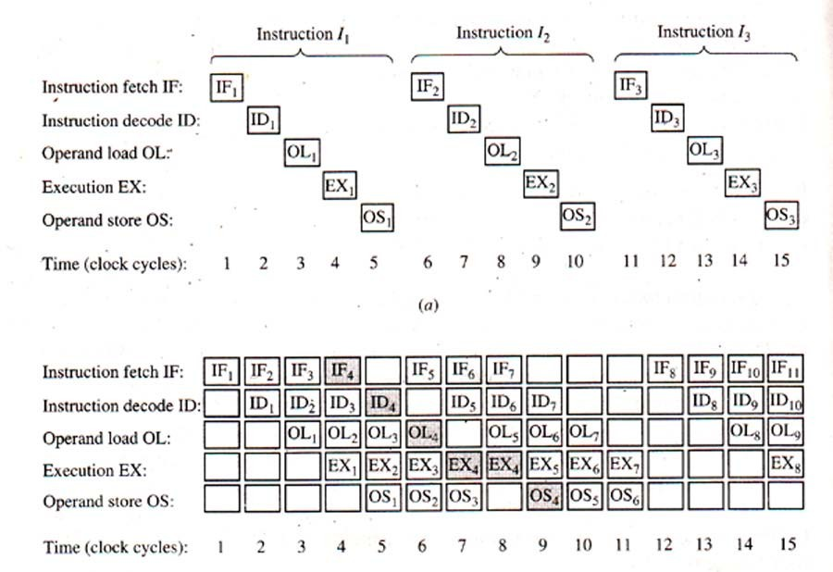
Sequential and Pipelined Processing

